Slide 1

Capstone Project
(Exploratory data analysis)
Global Terrorism Dataset
● -by Ashu Koche

Slide 2

Content
• Introduction
• Exploring Dataset
• Data Summary
• Problem Statement
• Data Cleaning and Handling
• Data Visualization
• Solutions to Business objective
• Conclusion/Recommendations

Slide 3
Introduction
● Global terrorism is a complex and constantly evolving phenomenon that
poses a significant threat to global security and stability. In recent years,
there has been a growing interest in using data-driven approaches to
better understand the patterns, trends, and dynamics of terrorism around
the world.
● The Global Terrorism Database (GTD) is a comprehensive dataset of
terrorist events around the world from 1970 to 2017. The dataset
contains over 181,691 incidents, including information on the date,
location, weapons used, and casualties.

Slide 4
Introduction
● In this project, I have use Python to explore and analyze the GTD, with the
goal of gaining insights into the patterns and trends of global terrorism.
● This project aims to contribute to a better understanding of the causes and
consequences of terrorism, and to inform policy and practice in the fields of
security, conflict resolution, and development.
● I have used various Python libraries and tools, such as NumPy, Pandas,
Matplotlib, to explore the data and answer questions such as:
1. Which countries are most affected by terrorism, and what factors contribute to their
vulnerability?
2. What are the most common types of terrorist attacks?
3. What is the number of attacks in specified regions? etc….

Slide 5
Exploring Dataset
⮚ The Global Terrorism Database (GTD) is a well-known open-source dataset that
contains information on terrorist attacks around the world from 1970 to 2017,
containing 206 Countries.
⮚ The dataset has 181691 rows and 135 columns. There are a ratio of 3/5 null values in
the dataset and no duplicate values in it.
⮚ In the given Dataset, most of the columns consist null values but those columns on
which the EDA have been conducted or questions have been analysed do not contain
the problem of null values.
⮚ From these 135 columns, I have used only 26 columns that have the most important
information in them.
⮚ The 26 columns contain information of such as date, month, year, countries name,
motive, region, attack type, and weapon type.
⮚ In some data, the information is incomplete no month and date available of the attack
and also which property was damaged. So, this data set kept those values as
Unknown.

Slide 6
Exploring Dataset
The name of the columns doesn't have the proper format to understand so, I have renamed them
accordingly. Below are some column names with information in it:
●
●
●
●
●
●
●
●
●
●
●
●
iyear
:Year of the attack
imonth
iday
:Month of the attack
:Date of the attack
country_txt
region_txt
city
:The names of the 205 attacked countries
:12 Region
:The city's name, which was attacked
attacktype1_txt
targtype1_txt
motive
:The list of attack type
:The main target of the attack
:Motive of the attack
weaptype1_txt
propextent_txt
propvalue
:The types of weapons used to attack the country/region
:Range of cost for the property destroyed
:The actual cost of the property destroyed

Slide 7
Data Summary
❏ df: It contains all the important 26 columns which are extracted from the df_main which is the
main data set.
❏ country_attacked: This data set contains the total number of attacks on countries, it having
205 countries' names.
❏ Year_of_attacke: This set includes the count of attacks every year and also the trend of
attacks.
❏ weapons_used: Types of weapons used in terrorist attacks.
❏ property_loss: This dataset was used to identify the loss of property.
❏ loss_of_property_country_wise: This dataset also was used to identify the loss of property
however country-wise.
❏ region_wise_property_loss: This dataset contains the loss of property Region-wise.
❏ choro_df: It includes the count of the attack region wise.
❏ attack_file: The dataset contains the target type and attack type of the attacker’s Region-wise.

Slide 8
Problem Statement
❏ Terrorism is a complex and multifaceted phenomenon that affects countries and communities
around the world.
❏ The Global Terrorism Database (GTD) is a valuable resource for studying the patterns and
trends of terrorism, but analyzing such a large and complex dataset can be a daunting task.
❏ What are the limitations of the Global Terrorism Database, and how might these impact our
analysis and conclusions?
❏ How can the insights from our analysis be used to inform policy decisions and improve counter
-terrorism strategies?
❏ How accurate is our predictive model, and what factors contribute to its success or failure?

Slide 9
Problem Statement
The project will address the following questions:
● Which countries are most affected by terrorism, and what factors contribute to their
vulnerability?
● What are the most common types of terrorist attacks?
● How do they impact different parts of the world?
● How has the frequency of terrorist attacks changed over time?
● Are there any patterns or trends in the types of weapons used in terrorist attacks?
● Which types of weapons are used most in different types of attacks?
● What is the number of attacks in specified regions?
● What is the categorisation of different affected property types in various Regions.
● Which weapons are used in specific regions according to the target type?

Slide 10
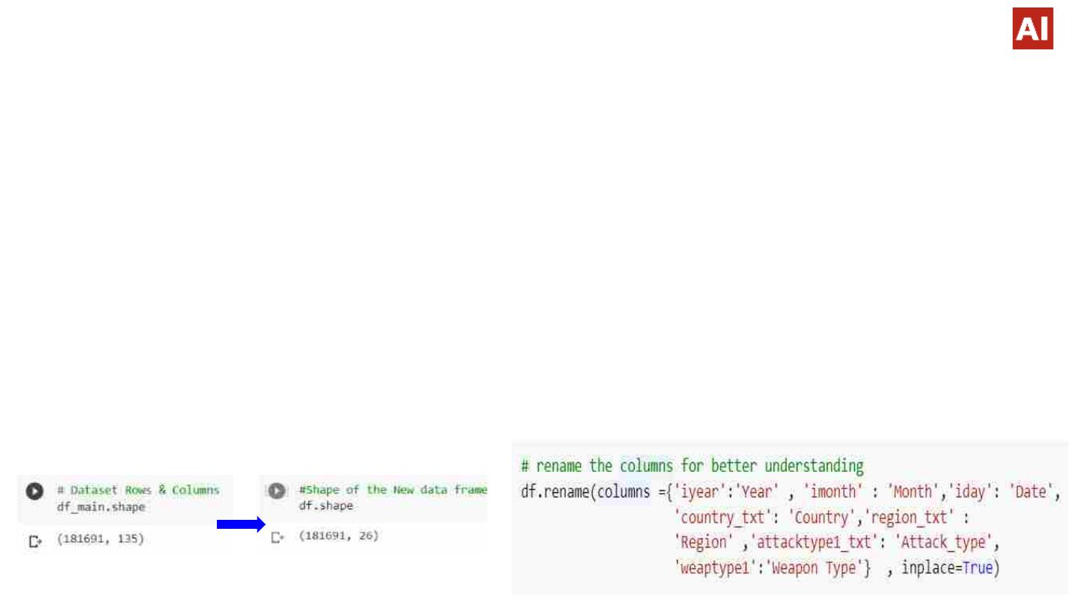
Cleaning and Handling Dataset
❖ There are no duplicate columns but it having the many unique values in it.
❖ Created a copy of the dataset so that the original dataset cannot be harmed.
❖ Column names of this dataset have different names than usual hence rename
them accordingly to easily understand. eg. {'iyear':'Year' , 'imonth' : 'Month','iday': 'Date',
'country_txt': 'Country','region_txt' : 'Region' ,'attacktype1_txt': 'Attack_type', 'weaptype1':'Weapon Type'}
❖ Extracted the only important 26 columns to the new dataset which has the most
important data to find the insights.

Slide 11
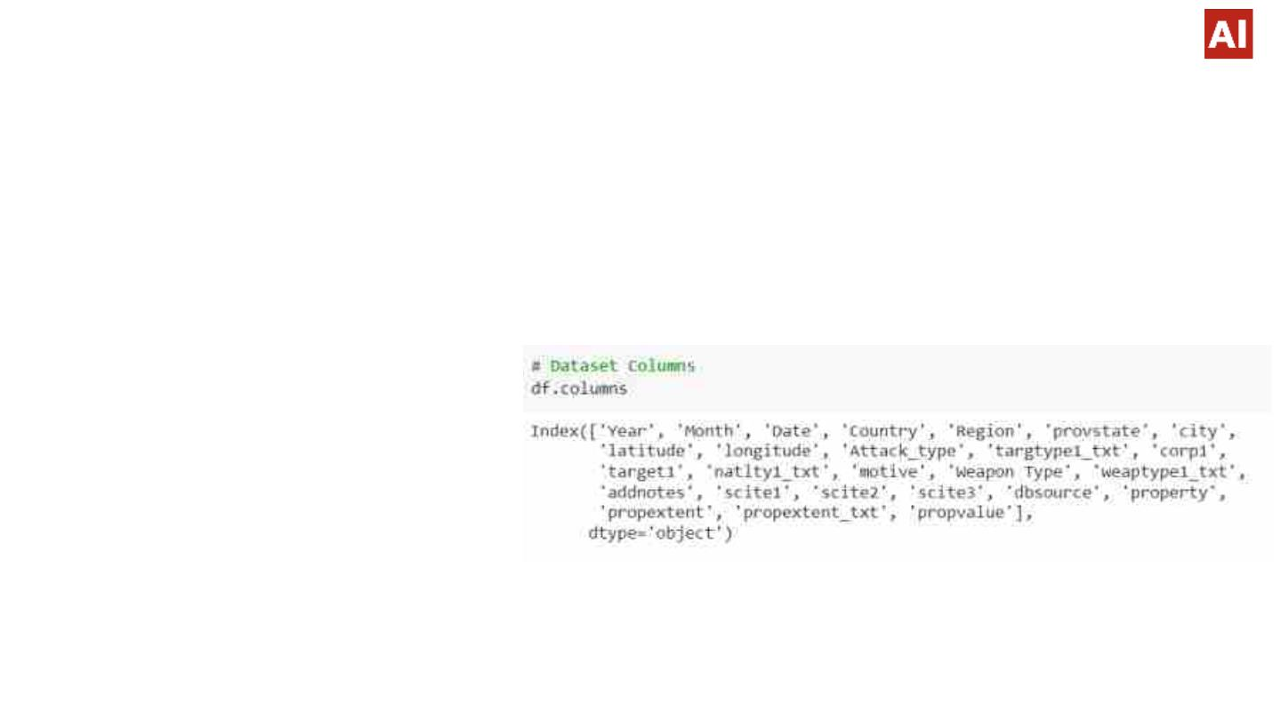
Cleaning and Handling Dataset
❖ These are the 26 columns that I have extracted.
● provstate: State which was attacked
● city: City of attack
● latitude: The latitude of the attack location
● longitude: The longitude of the attack location
● Attack_type: The type of attack
● targtype1_txt: The type of target.
● corp1: The incident belongs to corporate
● target1: Who is the target!
● natlty1_txt: Country
● motive: Motive of the attacker
● addnotes: Notes about the attack
● scite1, scite2, scite3: Brief notes about the attack
● propextent_txt: Tyme of property destroyed according to cost
● propvalue: The cost of the property destroyed

Slide 12
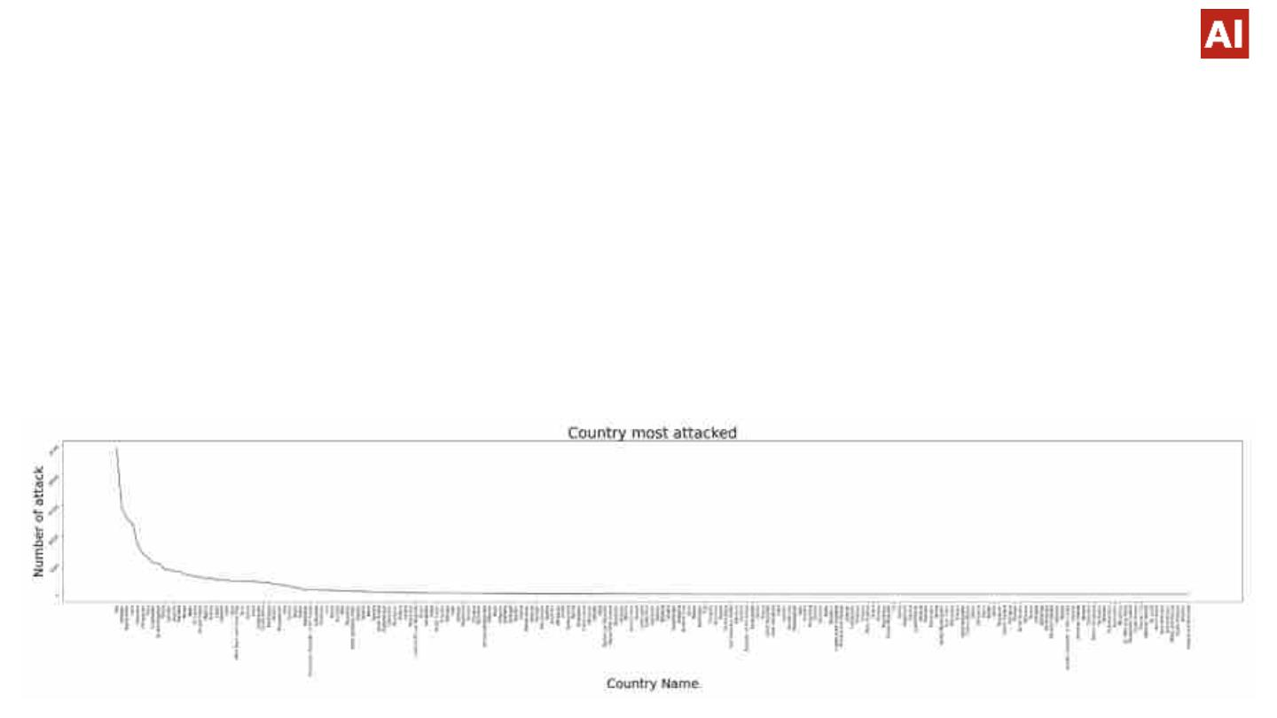
Data Visualization
Countries that have experienced the most terrorist attacks
❏ From the below Lineplot, we can able to identify the top 10 countries that were
attacked the most and the 10 safest countries to be counted with a smaller
number of attacks.
❏ We can analyze that the most attacked country is Iraq, Pakistan, Afghanistan,
India, Colombia, Philippines, Peru, El Salvador, United Kingdom, and Turkey.

Slide 13
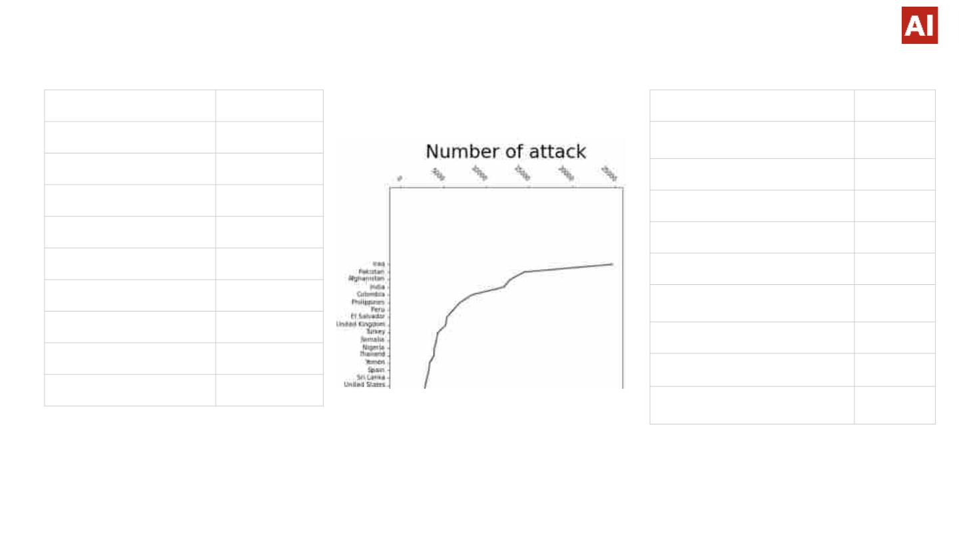
Data Visualization
Iraq
24636
14368
12731
11960
8306
6908
6096
5320
5235
4292
Vatican City
1
Pakistan
Afghanistan
India
Falkland Islands
St. Lucia
1
1
1
1
1
North Korea
New Hebrides
International
Colombia
Philippines
Peru
Wallis and Futuna
South Vietnam
Andorra
1
1
1
El Salvador
United Kingdom
Turkey
Antigua and Barbuda
1
❏ This Dataset is very useful to understand the core depth of the security followed by the countries, which needs to
be improved.

Slide 14
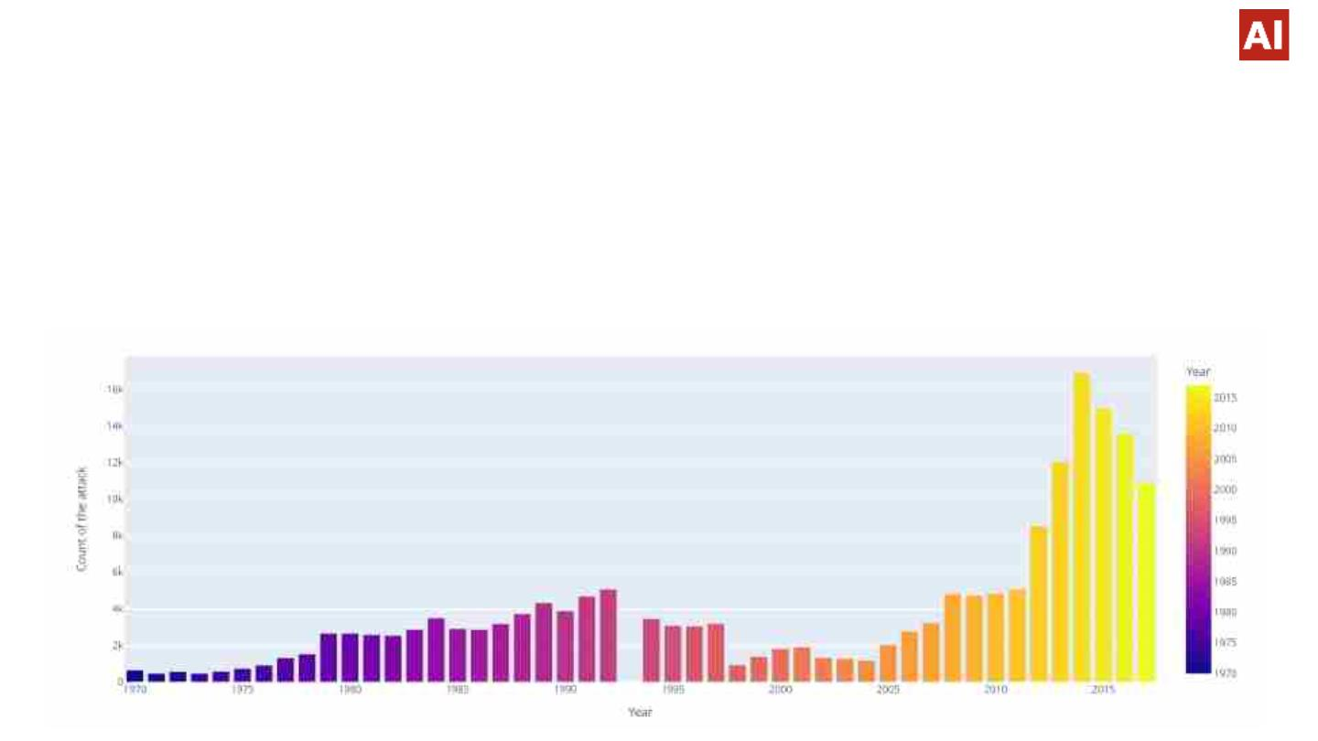
Data Visualization
The frequency of terrorist attacks changed over time
❏ The Barplots represent the value count of the attack every year. The significant attacks were happened in 2014.
Also, the number of terrorist attacks is increasing every year.
❏ If we observe between 2000 to 2005 the attacks were slightly reduced compared to the rest of the years. Also, after
2014 the attack ratio is reducing in 2015,2016, and 2017. That represents after 2014 the countries are taking
small steps to improve security on a priority basis.

Slide 15
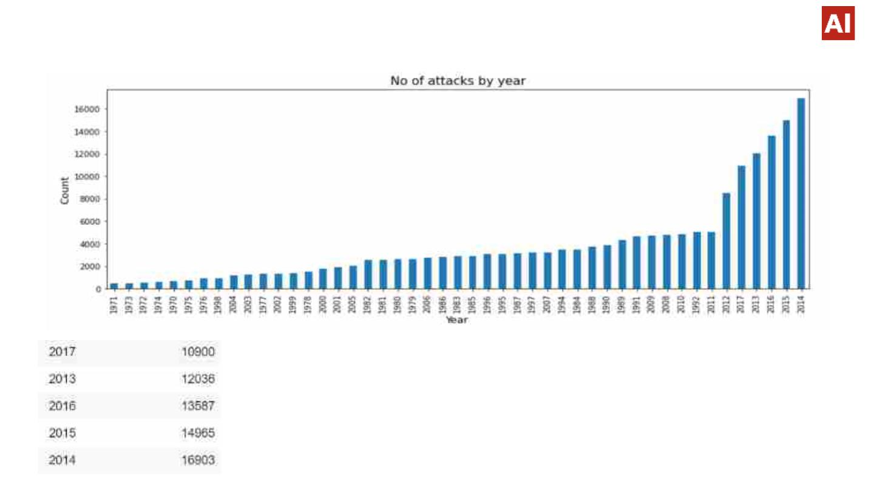
Data Visualization
Year
No of attacks
❏ Calculating the number of terrorist attacks on countries can help in assessing the level
of risk of terrorist attacks for businesses or organizations operating in those countries.
So that they can improve security.

Slide 16
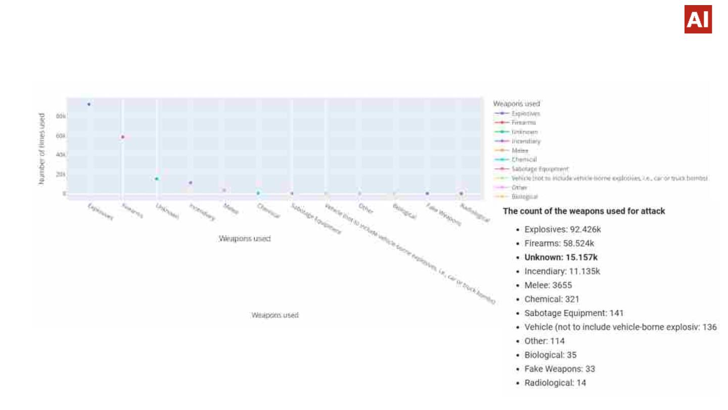
Data Visualization
The patterns or trends in the types of weapons used in terrorist attacks.
From above Line plot the types of weapons used in terrorist attacks is providing the
insight into the types of weapons that are most commonly used by terrorists which is
Explosives and Firearms. This can suggest that the group has access to more
sophisticated and advanced weapons.
The Unknown weapon used in attack, it may increase the risk of copycat attacks by
other groups or individuals. The lack of information about the weapon used may make
it easier for other groups to emulate the attack or develop similar tactics, making it
more challenging for us to prevent future attacks.

Slide 17
Data Visualization
Types of weapons used in most in different types of attacks
Explosives : 92.426k
Firearms : 58.524k
Incendiary : 11.135k
●
●
●
●
●
●
●
●
Pipe Bomb
Dynamite/TNT
Pressure Trigger
Time Fuse
Vehicle
Letter Bomb
Grenade
Landmine
●
●
●
●
Unknown Gun Type
Automatic or Semi-Automatic Rifle
Handgun
●
●
●
Molotov Cocktail/Petrol Bomb
Gasoline or Alcohol
Arson/Fire
Rifle/Shotgun (non-automatic)
Chemical :
Unknown: 15.157k
11.135k
Poisoning
Explosive
Unknown
●
●
●
Melee : 3.655k
●
●
●
●
●
●
Blunt Object
Knife or Other Sharp Object
Hands, Feet, Fists
Suffocation
Rope or Other Strangling Device
Unknown Weapon Type
❏ Here the weapon used in a terrorist attack is Unknown, it may be more
difficult to analyze the attack and draw conclusions. The lack of
information about the weapon used can limit the available data and make
it harder to draw definitive insights.

Slide 18
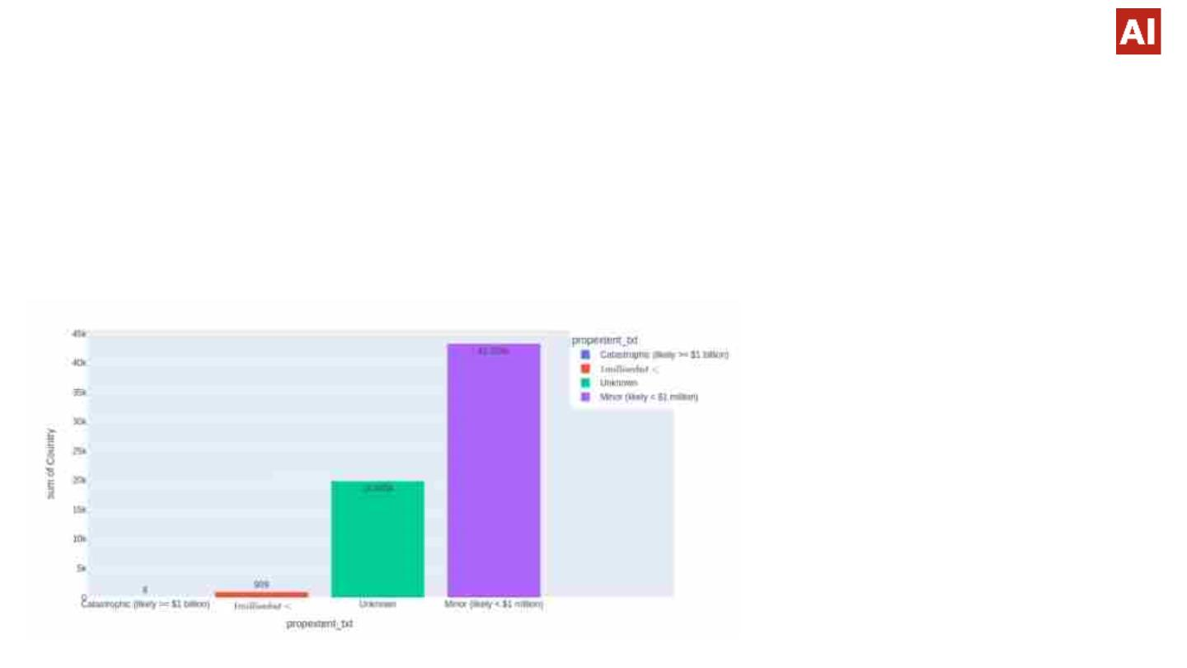
Data Visualization
Visualizing of lost property in an attack
❏ The above bar plot provides the impact of terrorism on infrastructure, the economy, and the local population. It
is showing the cost of repairing or replacing damaged infrastructure, lost productivity, and the impact on
tourism and other industries.
❏ We can identify that most of the suffering people are lower-class people which falls under the property loss
below $1 million.
●
●
Catastrophic (likely >= $1 billion) = 6
Major (likely >= $1 million but < $1 billion) =
909
●
●
Unknown = 19.846k
Minor (likely < $1 million) = 43.304k

Slide 19
Data Visualization
❖ Catastrophic (likely >= $1 billion) = 6
●
●
●
Destroyed historic buildings and damaged surrounding buildings, estimated at $2,700,000,000 (London financial district)
1996: Huge explosion rocks central Manchester.
The crash of the plane resulted in the destruction of an American Airlines Boeing 767 aircraft.
❖ Major (likely >= $1 million but < $1 billion) = 909
●
●
●
●
Store destroyed
Building partially destroyed
Warehouse destroyed and buildings in Oxford damaged
Auditorium, including the floor and the roof. Archive and part of the library, as well as a transformer station.
●
Petroleum storage tanks
❖ Unknown = 19.846k
❖ Minor (likely < $1 million) = 43.304k
●
●
●
●
●
Transformers were damaged.
Basketball courts, swimming pool, gymnastic equipment, Windows shattered, Restroom damaged.
Army personnel carrier was damaged
Numerous other vehicles damaged
Class rooms and offices were destroyed.

Slide 20
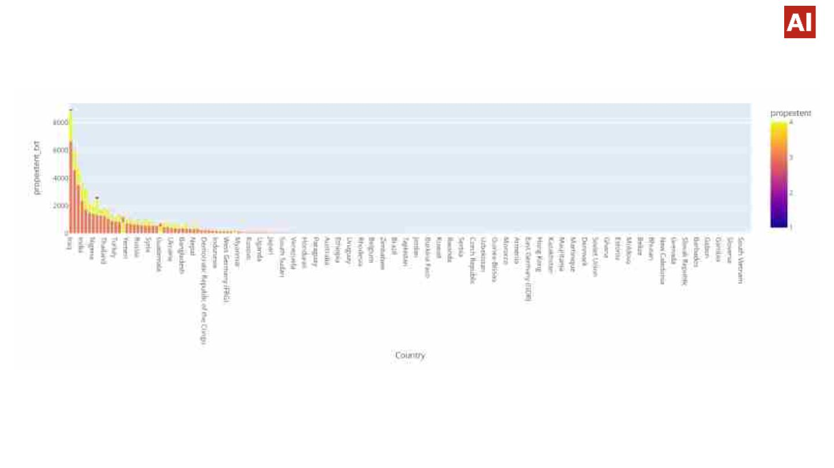
Data Visualization
The categorisation of different affected property types in various
Regions.
❏ This histogram shows how much the countries suffered from property loss with every attack.
❏ The most affected countries are Iraq, Pakistan, Afghanistan, India, El Salvador, Philippines, Nigeria,
Colombia, United States, Thailand, and Peru.
❏ The above data it is reflecting that the number of attacks on countries is directly proportional to the loss of
property.

Slide 21
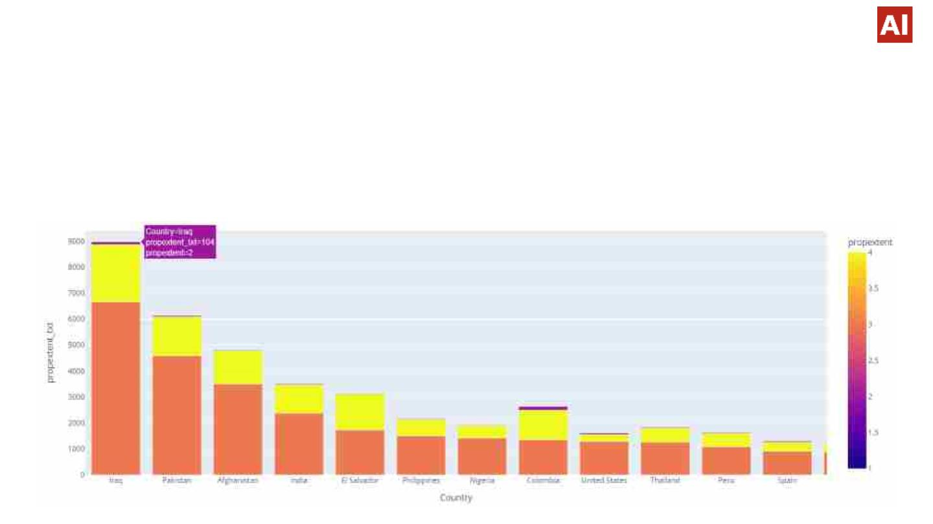
Data Visualization
Pakistan
Afghanistan
India
Minor (likely < $1 million) = 4583
Unknown = 1580
Major (likely >= $1 million but < $1 billion) = 42
Minor (likely < $1 million) = 3500
Unknown = 1289
Minor (likely < $1 million) = 2376
Unknown = 1092
Major (likely >= $1 million but < $1 billion) = 31
Iraq
Minor (likely < $1 million) = 6665
Unknown = 2200
Major (likely >= $1 million but < $1 billion) = 104

Slide 22
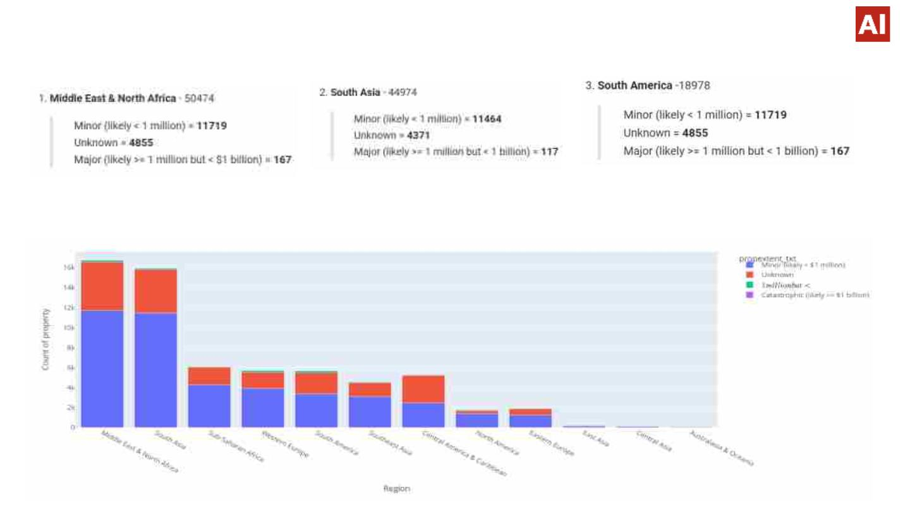
Data Visualization
❏ The information would help countries common in the region to cultivate a cumulative and collective plan against
terrorist attacks. Also, to make the economy strong enough to sustain such attack.

Slide 23
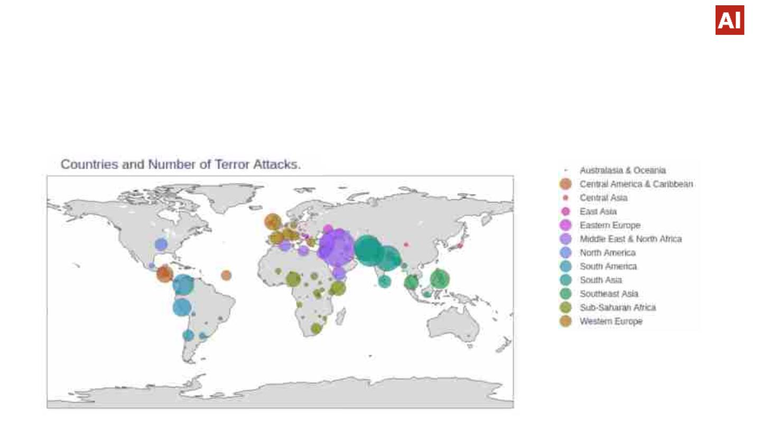
Data Visualization
The number of terror attacks, encountered by individual region.
❏ Analyzing the property destroyed in terrorist attacks over different regions can provide insights into the
economic impact of terrorism in those regions. This includes the cost of repairing or replacing damaged
infrastructure, lost productivity, and the impact on tourism and other industries.

Slide 24
Data Visualization
❏ The Choropleth is showing the most impacted Region is the Middle East & North Africa. The
Region which is less affected by this attack over the cost is Australasia & Oceania. The major
loss of the region
❏ The property destroyed in terrorist attacks over different regions over time can reveal trends in
the types of targets being attacked and the impact of those attacks.
❏ The major loss of the region Middle East & North Africa as well as South Asia affects all the
economic growth hence this region needs to develop strategies to address those vulnerabilities.
❏ E.g In Western Europe, the number of attacks encountered by Private Property due to Armed
Assaults.It gives the idea about, most notorious attack type , their frequency and most
vulnerable target in every region.

Slide 25
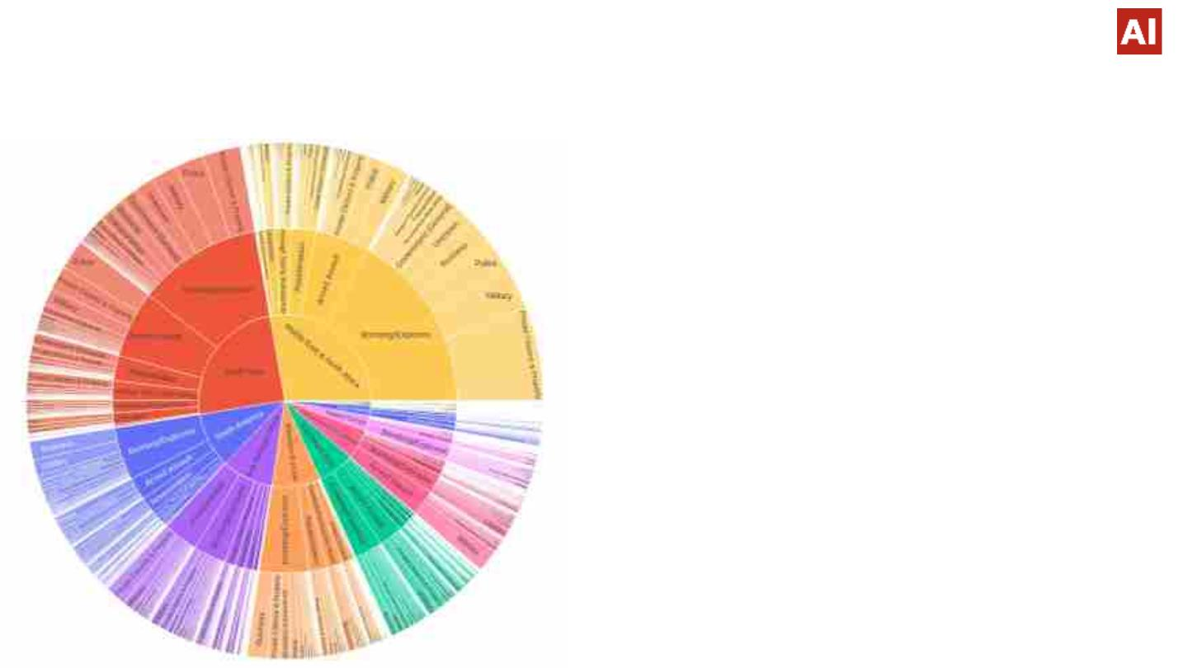
Data Visualization
The number of attacks on different target types according to the different attack types specified in the
Region
❏ Sunburst provides some beautiful functionalities
to users. The Data consists of some interlinkages
with each other. So, to represent the relation
between 'Region' and 'Attack Type' it is the most
suitable graph.
❏ In most of the regions,Bombing and Explosions
is the most frequent attack type.Nearly every
region is severely affected due to the Bombing
and Explosions.
❏ The number of attacks on different target types
according to the different attack types specified in
the Region.
❏ When countries got to know about the most
frequent attack type, they work directly on
prevention and dissemination of weapons related
to the attack type.It will help them to regulate the
law and order according to the type of attack.

Slide 26
Solutions to Business objective
❏ The Countries must work on comprehensive anti terror policies. Such Policies can be
formulate in organisation like United Nations Security Councils.
❏ In today's new World order multilateralism is appreciated by most of the regions and
their respective countries. This new way of diplomacy could also be helpful for curbing
the menace of terrorism.
❏ Economy , Polity or Science could change with time and fluctuate but the Geography
of countries never changed. If the same geography remained attached and aligned,
where focus is on dissolving the boundaries and not demarcating the boundaries ,
problems like terrorism can never dominate over strong steadfast stature of countries.
❏ So deep connection between countries, people to people relations , respecting each
other's foreign policy and not involving with any non state actors(for any kind of ill
attack) will fetch countries strength and resilience to fight through any terror attacks.

Slide 27
Conclusions
• Analyzing the effectiveness of counterterrorism policies and strategies can help to
identify areas where improvements could be made.
• Exploring the Global Terrorism Dataset can help to identify trends and patterns in terrorist
attacks over time, such as changes in the frequency, location, or methods of attacks.
• When the Taliban took control of Afghanistan, the whole world felt the grief of the Afghan
people. Terrorism destroys every right and batters the person to his frightening death.
• In the above analysis, various study heads have been found which could be easily
studied by countries to curb the menace of terrorism.
Terrorism do not just destroys the land but it destroys the peace,harmony, trust
on humanity, the whole youth and cultivates the seeds of hatred and envy.

Slide 28
Thank You!!

